Slide 1

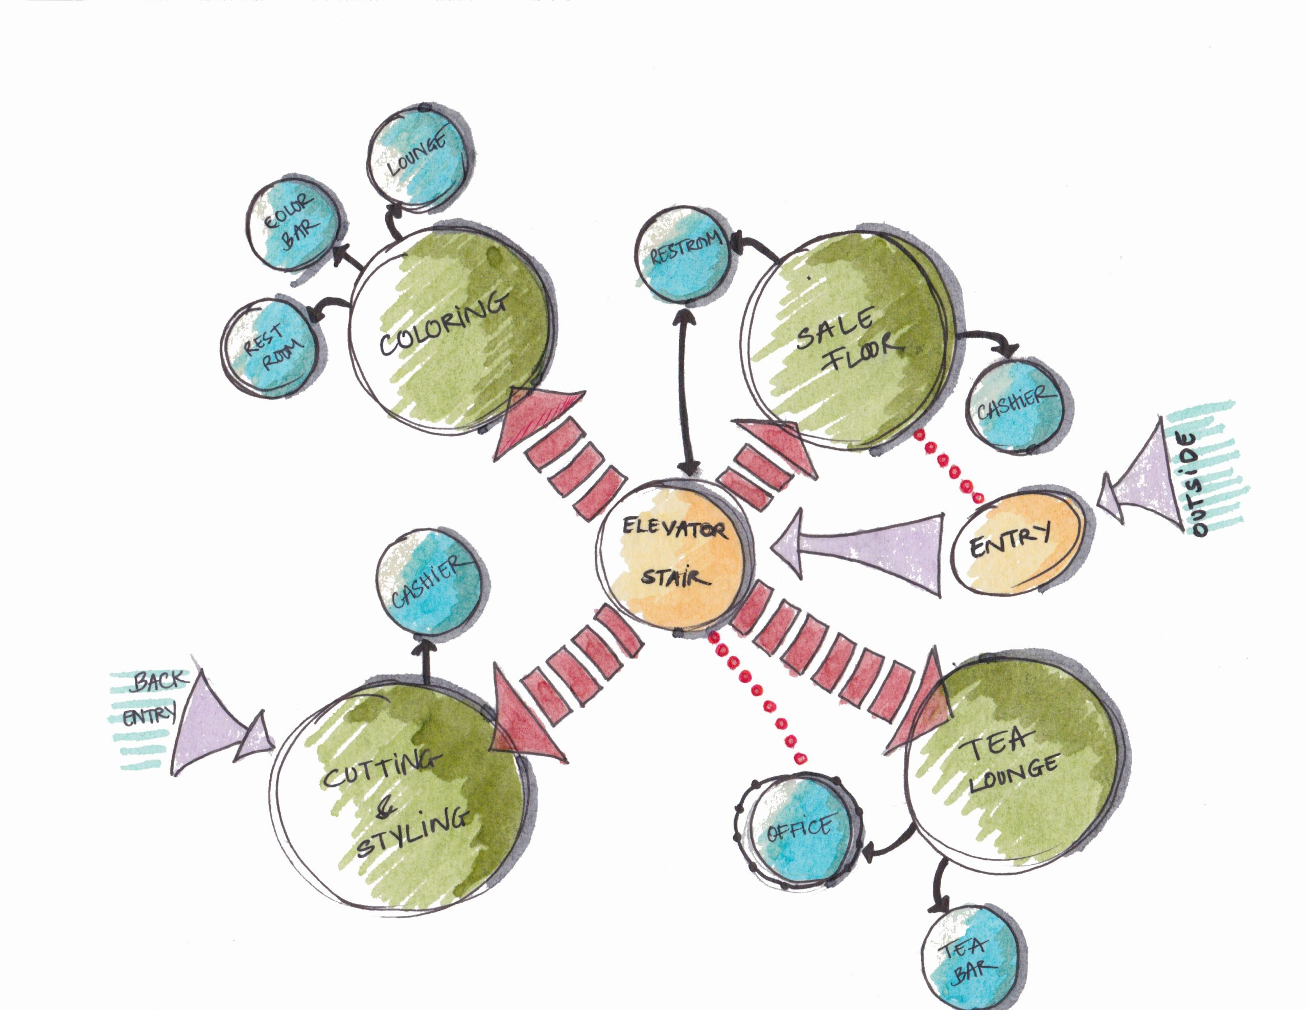
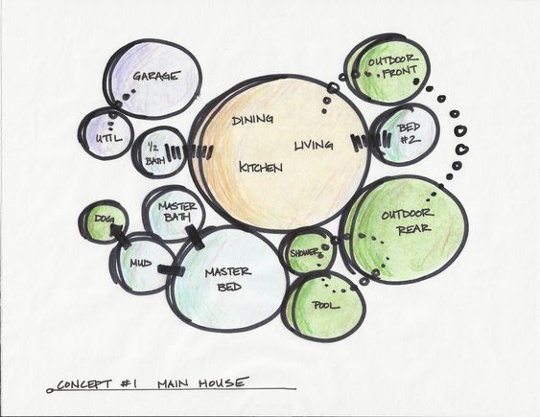
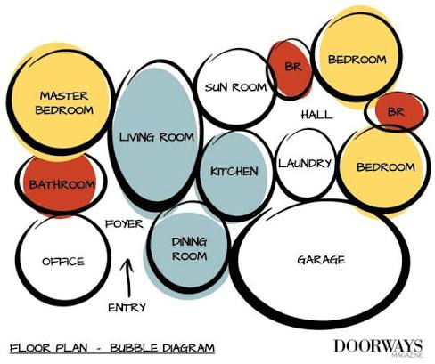
Individual Activity
Find out your Case Study Bubble Diagram by hand sketch.
share via e Portfolio

Slide 2
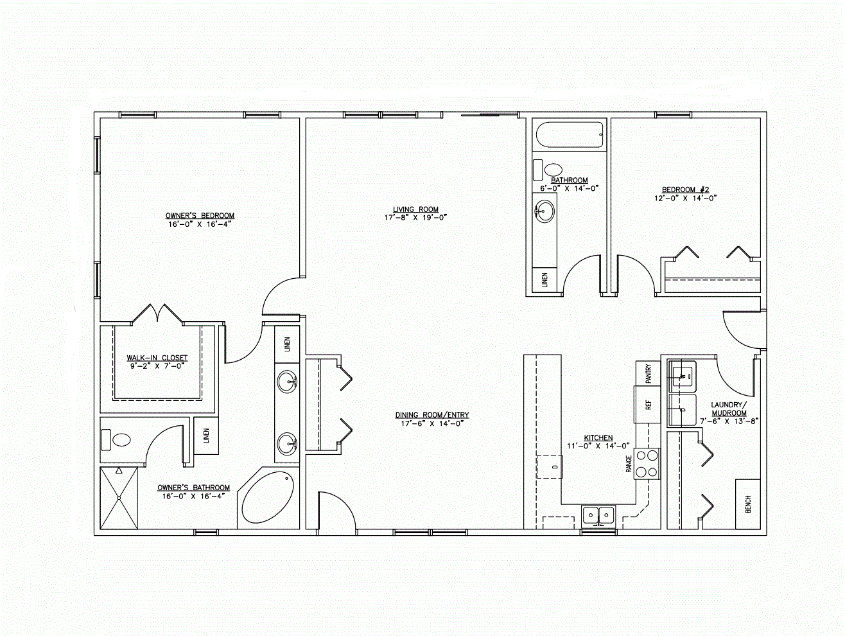
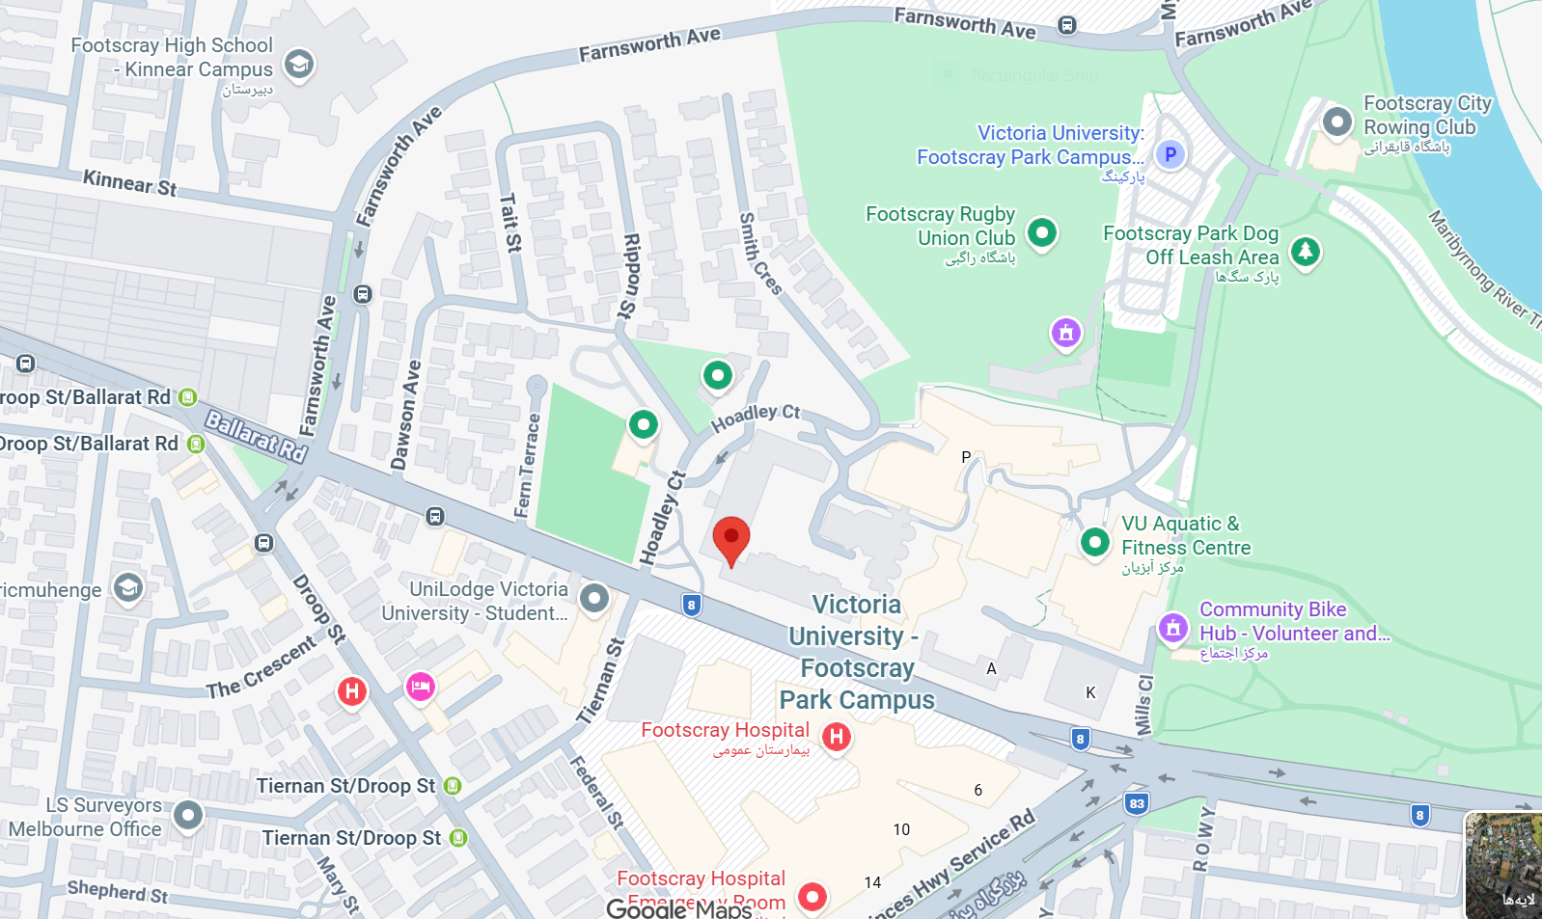
Individual Activity
Practice sample:
plan & site analysis by Adobe Photoshop.
- share via e Portfolio

Slide 3
Individual Activity
presentation of Portfolio Stage 1 included plan & site analysis.
- share via e Portfolio

